Slide 1

Jefferies Industrial
Conference
August 2015

Slide 2
Cautionary Statement
Information included in this presentation may contain statements, including earnings projections, that are forward-looking in nature and, accordingly, are subject to risks and uncertainties regarding Snap-on’s expected results. Statements made that (i) are in the future tense; (ii) include the words “expects,” “anticipates,” “intends,” “approximates,” “plans,” “targets,” “estimates,” “believes,” or similar words that reference Snap-on or its management; (iii) are specifically identified as forward-looking; or (iv) describe Snap-on’s or management’s future outlook, plans, estimates, objectives or goals, are forward-looking statements within the meaning of the Private Securities Litigation Reform Act of 1995. The company’s actual results may differ materially from those described or contemplated in the forward-looking statements. Factors that may cause the company’s actual results to differ materially from those contained in the forward-looking statements include those found in the company’s reports filed with the Securities and Exchange Commission, including the information under the “Safe Harbor” and “Risk Factors” headings in its Annual Report on Form 10-K for the fiscal year ended January 3, 2015 and under “Management’s Discussion and Analysis of Financial Condition and Results of Operations – Caution Regarding Forward-Looking Statements” in its fiscal 2014 and fiscal 2015 Quarterly Reports on Form 10-Q, which are incorporated herein by reference. Snap-on disclaims any responsibility to update any forward-looking statement provided during this presentation, except as required by law.

Slide 3

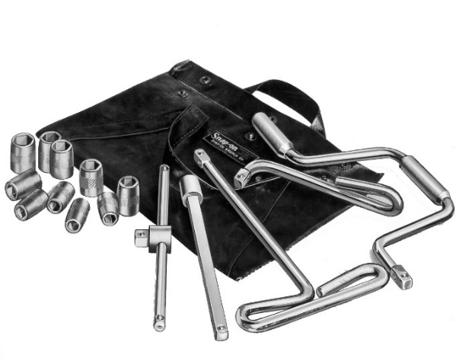
Snap-on Overview
Founded on innovation in 1920
Makes work easier for serious professionals performing critical tasks
Unique brand strength
11,400 associates worldwide
Serves professionals in over 130 countries
2014 net sales: $3.3 billion
NYSE: SNA / S&P 500
$9.8B Market Cap
1.3% Cash Dividend Yield
  Dividends paid without interruption or reduction since 1939
“Five Do the Work of Fifty”

Slide 4



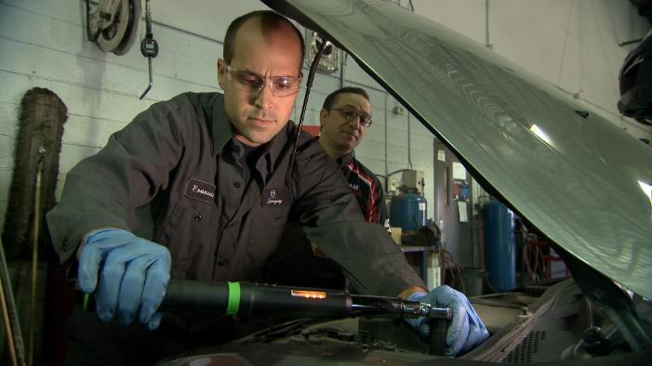
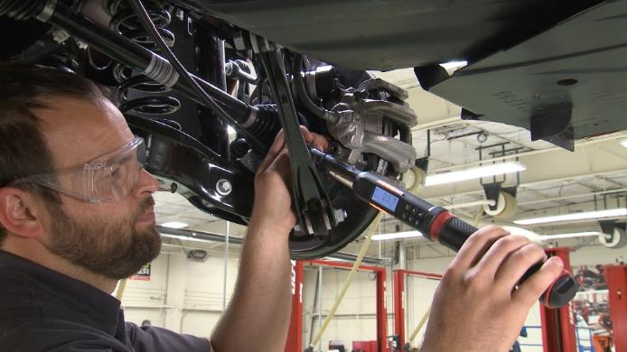
Snap-on is Shaped by Work

Slide 5
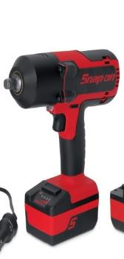
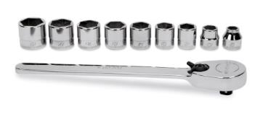
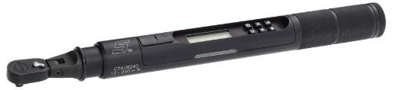
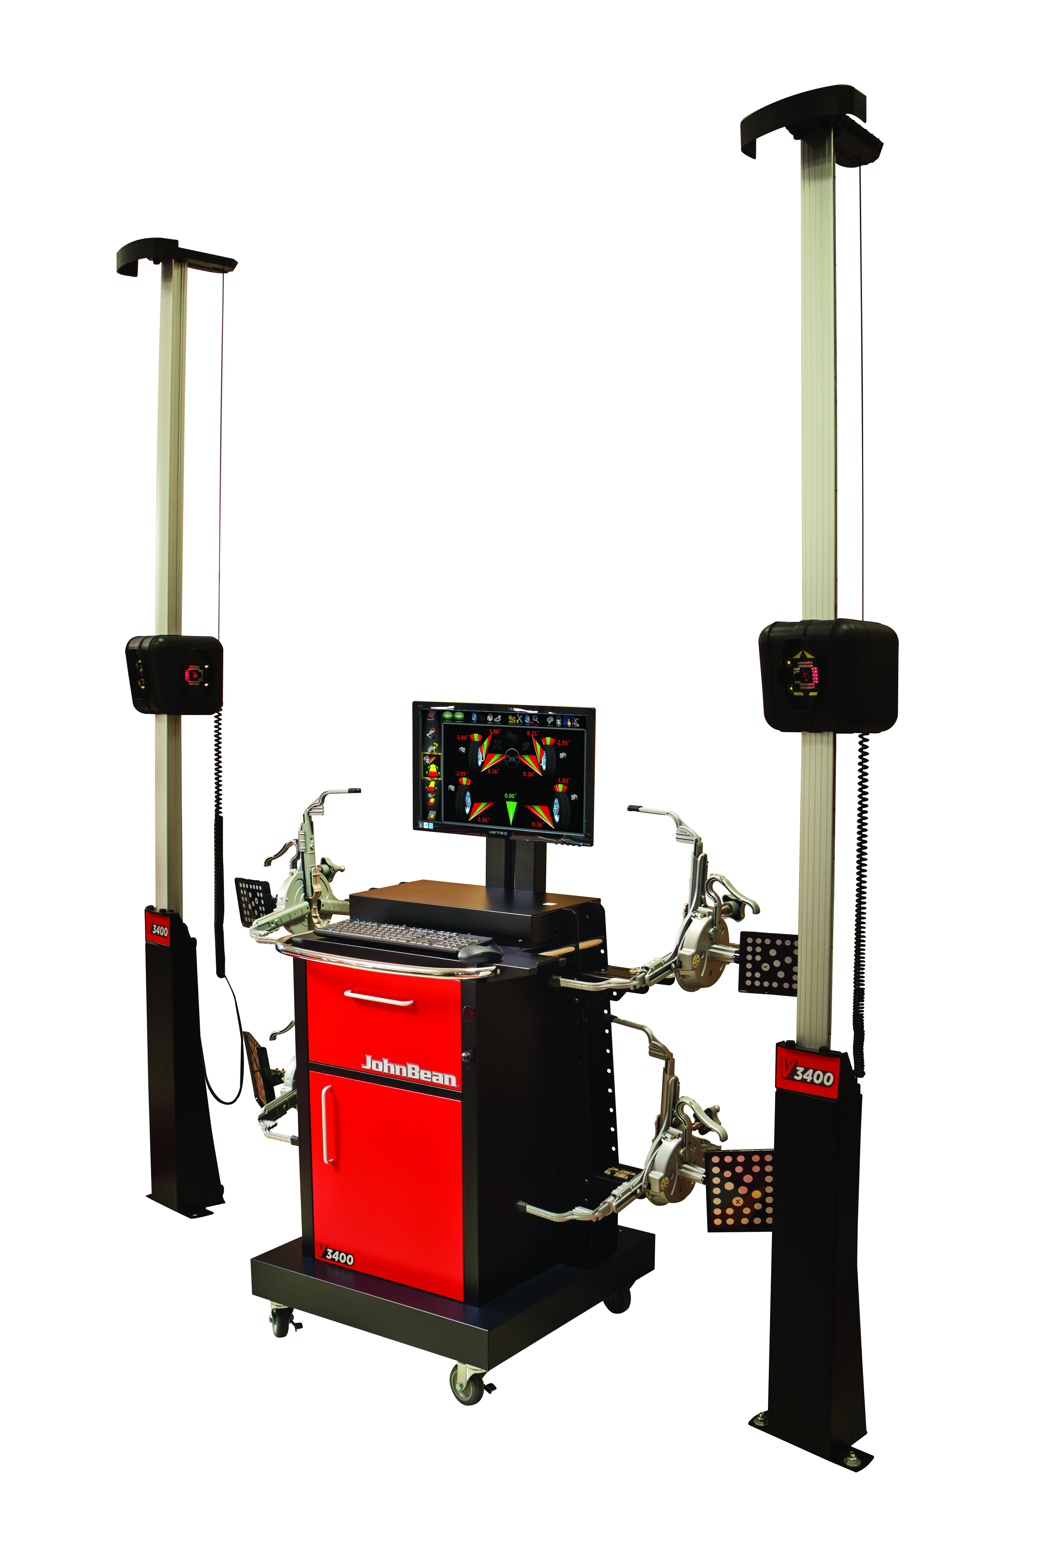
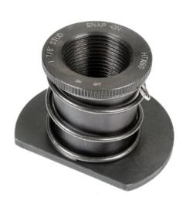
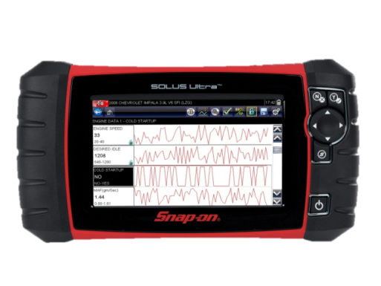
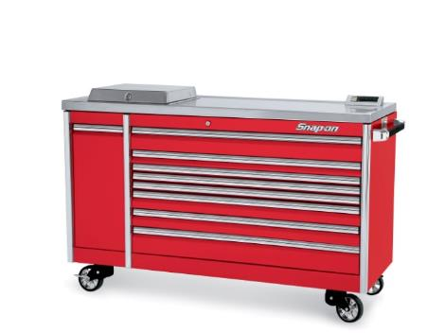
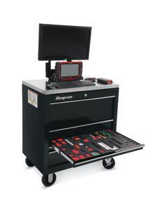
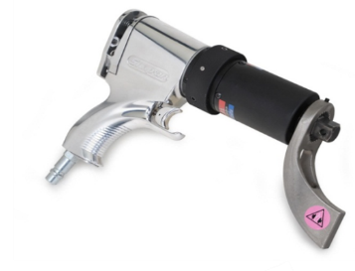
Snap-on is Sparked by Ideas -
Unique Productivity Solutions

Slide 6
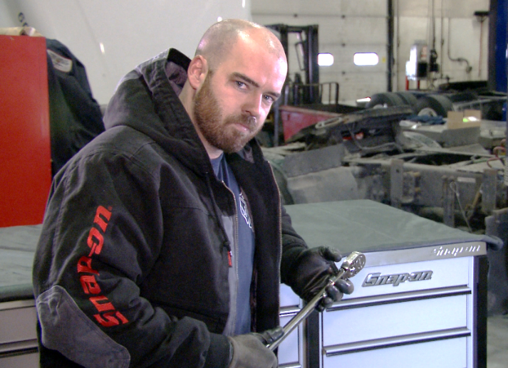
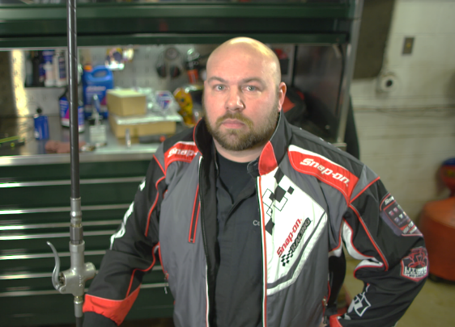

Snap-on is Celebrated by Professionals
Our brand conveys to professionals a special pride and dignity, making Snap-on a name they aspire to call their own
Notes:
Our customers are professionals who perform critical tasks...where precision and control are required...in harsh and punishing environments...where the cost of failure is high…
Snap-on helps our customers perform this work with repeatability and reliability; our brand conveys to them a special pride and dignity making Snap-on a name they want to call our name their own

Slide 7










Unique Brand Strength

Slide 8
Organized to Reach Our Primary Customers:
Operating Segments
Financial Services
Repair Systems & Information Group (RS&I):
  Vehicle repair shop owners and managers
Commercial & Industrial Group (C&I):
  Professionals in a broad range of critical industries
Snap-on Tools Group (Franchised Van Business):
  Vehicle repair technicians
2014 revenues by segment

Slide 9
U.S. Vehicle Aging
Drives Service Growth
2015
11.5 years
Age
in Years
Source: R.L. Polk, Co 2014
Source: iHS Automotive
Notes:
9

Slide 10
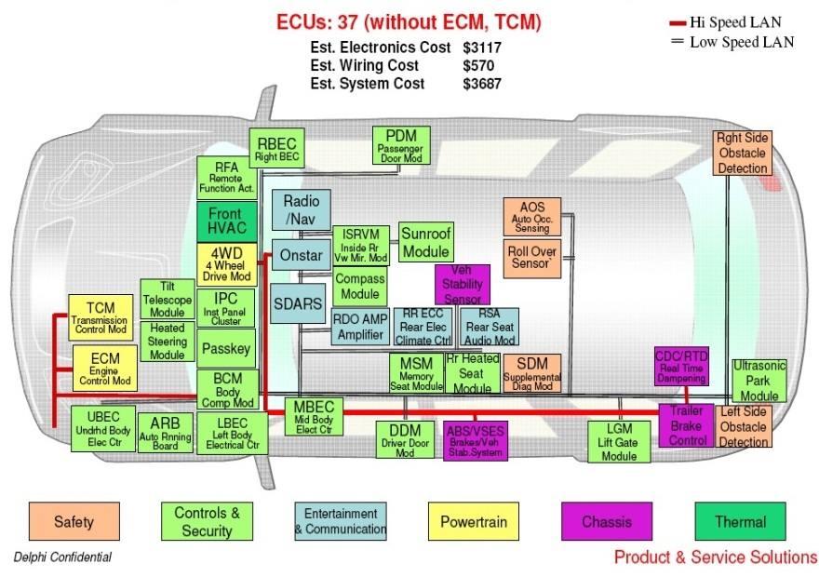
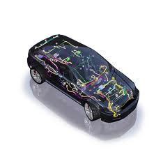
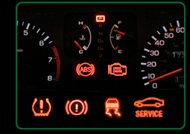
Vehicle Technology & Complexity
Provides Opportunity
Increasing vehicle complexity
Testing and re-programming requirements expanding
Repair information growing
Over half of vehicle repairs now require diagnostic tools
Productive shop management rising in importance
Emerging vehicle technologies create new solution needs

Slide 11
The Way Forward:
Runways for Improvement
Runways for Growth

Slide 12





Runways for Improvement:
Snap-on Value Creation
Safety
Cell Design
Quality
Customer Connection
Innovation
Rapid Continuous Improvement

Slide 13
Snap-on Value Creation: Safety
Associates are 92% less likely to experience a safety
incident today than in 2004
Safety Incident Rate
2014
74 Locations with
No Lost Time
Incidents
92% Reduction

Slide 14

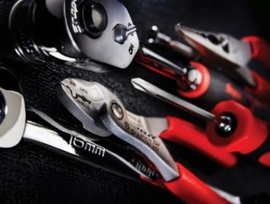

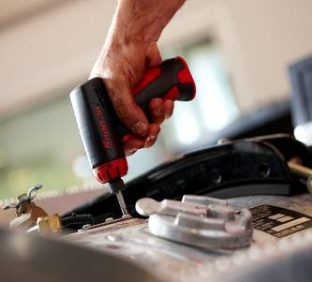
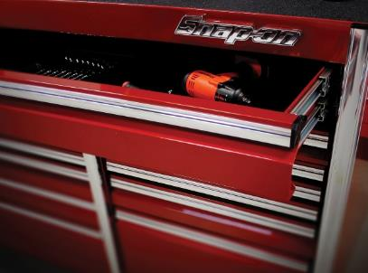
Snap-on Value Creation: Quality
Snap-on rated most preferred brand by U.S. auto technicians in multiple product categories of the latest Frost & Sullivan survey, including:
Hand Tools
Diagnostics
Power Tools
Tool Storage
70%
63%
47%
63%
11%
Next Brand
7%
Next Brand
11%
Next Brand
13%
Next Brand
Frost & Sullivan – 2015 United States (U.S.) Automotive Technicians’ Choice: Opportunities in the Automotive Tools Market

Slide 15
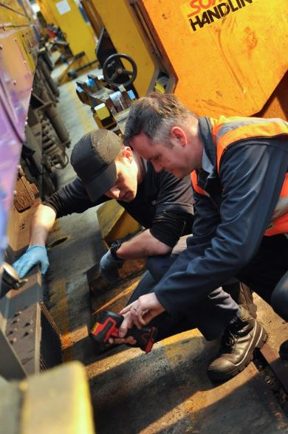

Snap-on Value Creation: Customer Connection
~4,800 mobile stores
Multiple direct sales forces
~700,000 N. American and European repair shops; repair networks in emerging markets growing rapidly
~2,500 vocational schools
Innovation Works: ~25,000 visitors
We Directly Observe Customers and Workplaces

Slide 16
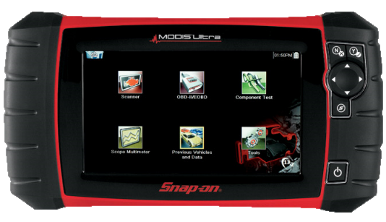

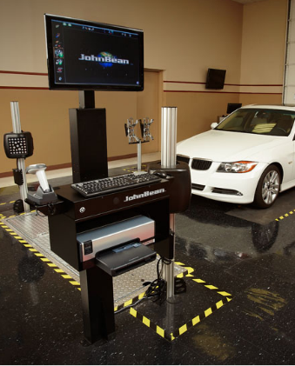
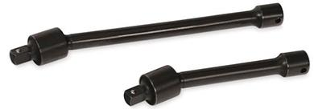
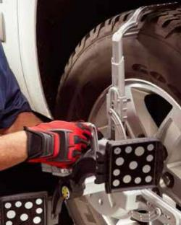
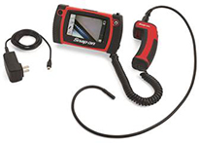


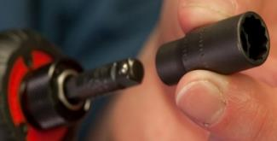

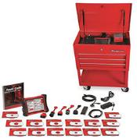

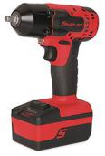
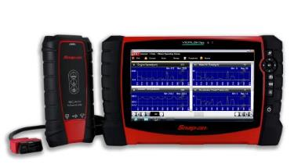
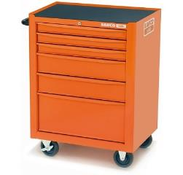

Snap-on Value Creation: Innovation -
New Product Awards and Successes
Possible + Practical = Innovation

Slide 17
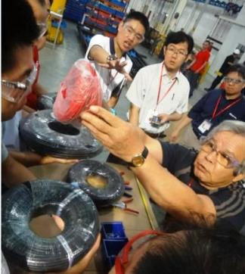
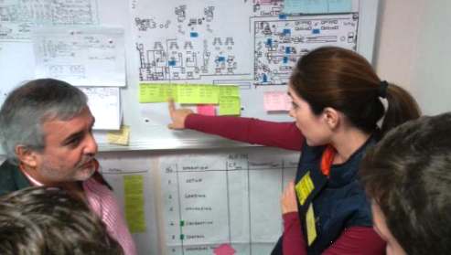
Snap-on Value Creation:
Rapid Continuous Improvement (RCI)
Operating income margin up 570 basis points since 2007

Slide 18
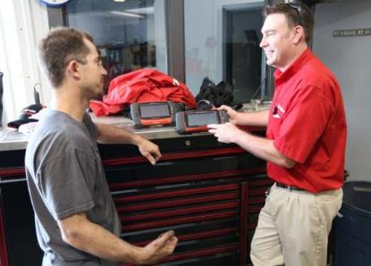
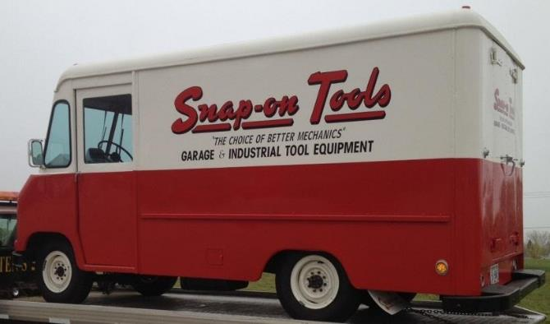
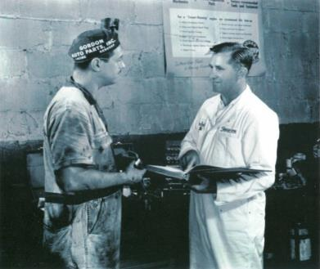
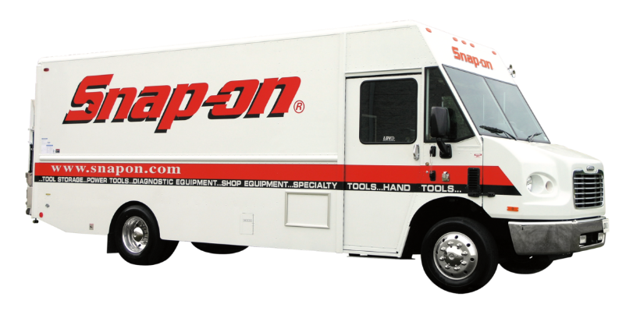
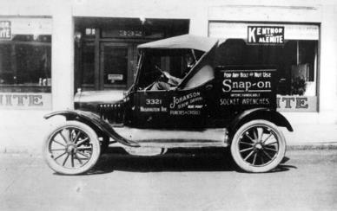
Snap-on Foundation
Selling Great Tools Through Vans to Vehicle Technicians

Slide 19

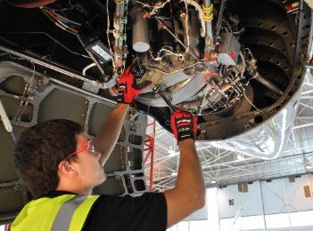

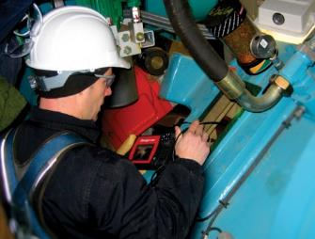

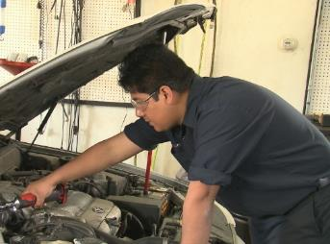
Snap-on More Broadly Defined
Make Work Easier
For Serious Professionals
Performing Critical Tasks
In Workplaces of Consequence

Slide 20

Runways for Growth
Enhance the franchise network
Expand with repair shop owners and managers
Extend to critical industries
Build in emerging markets
Investing in These Strategically Decisive Areas

Slide 21
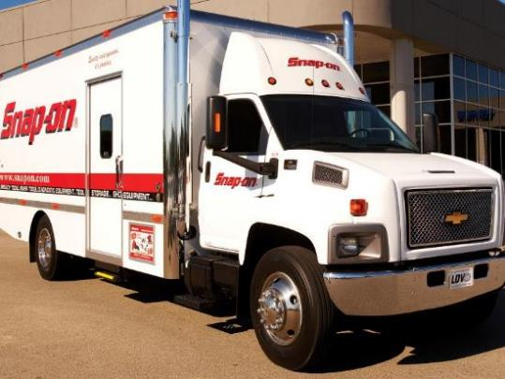

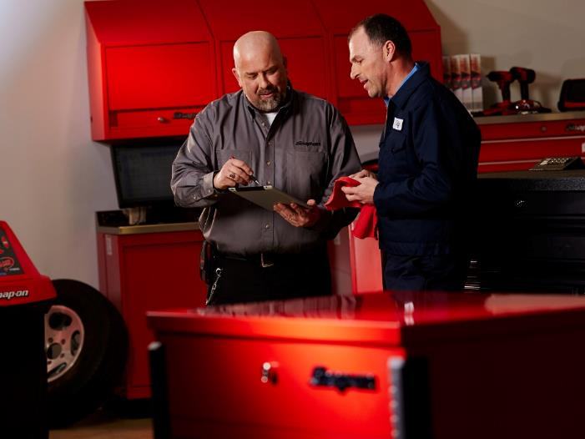
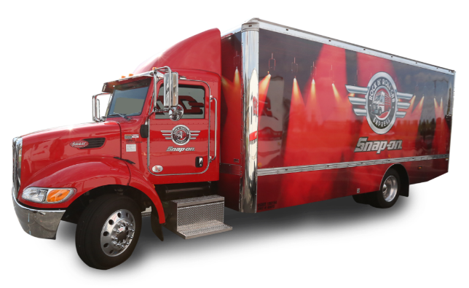
Enhance the Franchise Network-
Reach More Technicians
Maintain strong franchisee health metrics
Increase franchisee productivity
Improve coverage by filling routes more quickly
Innovate the selling process with programs aimed at amplifying the power of the van

Slide 22
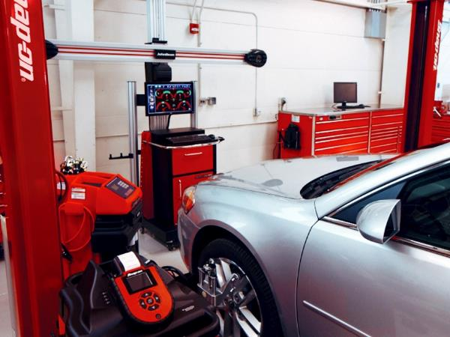
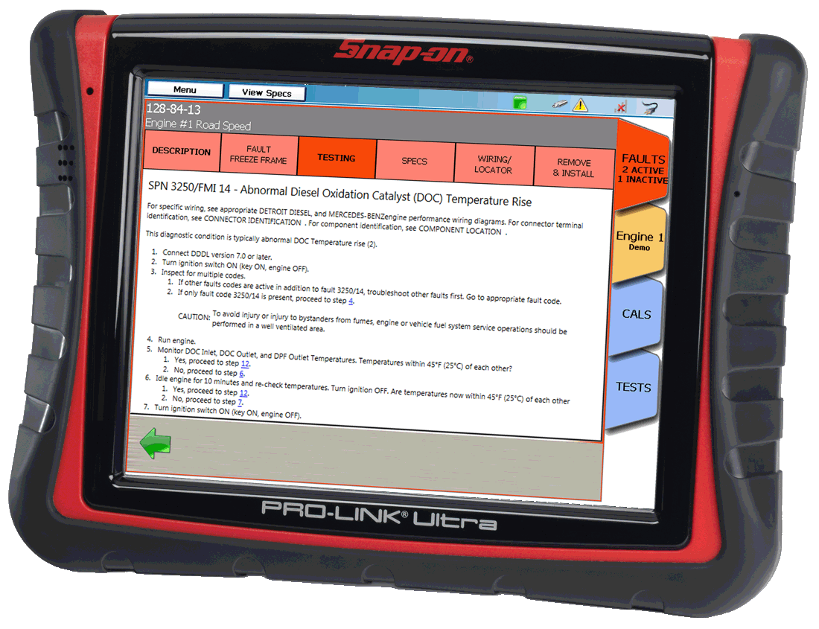
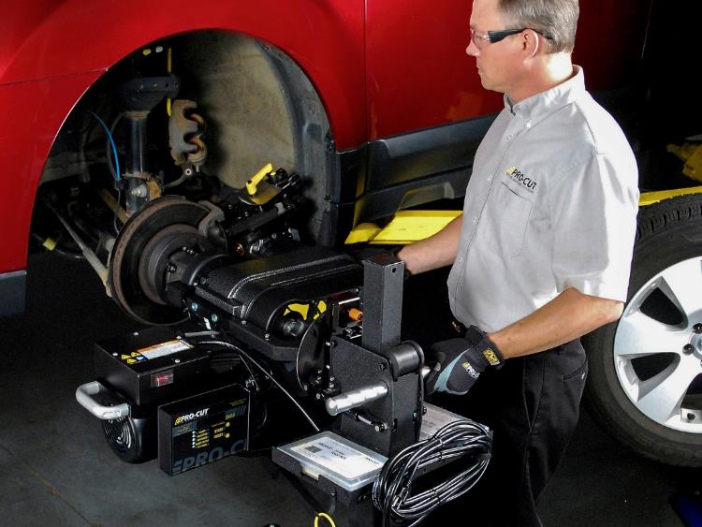

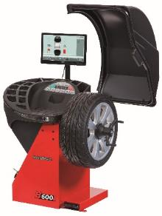
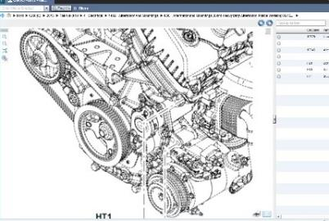
Expand with Repair Shop Owners and Managers
Leverage deep understanding of customers in parts and service operations
Help shop owners and managers improve both technical competency and business acumen
Grow and integrate broad capabilities
Create more to sell to this important customer group

Slide 23

Extend to Critical Industries
Serve more places where tasks with high consequences for failure require repeatability and reliability
Build a deep understanding of the work performed
Provide specialized productivity solutions for critical tasks

Slide 24
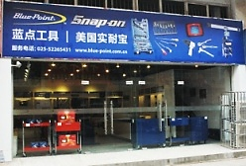




Build in Emerging Markets
Create manufacturing capacity
Establish distribution and sales reach
Launch new product lines

Slide 25

Net Sales and OI Margin Trend
* 2006 excludes $38.0 million legal settlement; including settlement, OI Margin was 6.1%
Notes:
25
25

Slide 26
Financial Services
Financial Services is both strategically important and a strong contributor to company earnings
* 2011 excludes $18 million arbitration settlement gain; including settlement gain, Financial Services operating earnings was $90.9 million
Notes:
26
26

Slide 27
Increased Dividends
20.5% Quarterly dividend increase November 2014; Dividends paid without interruption or reduction since 1939

Slide 28
Q2 2015 Summary Results
Organic Sales up 8.4%

Slide 29
Investment Rationale
Executing on defined and coherent strategies
Unique brand and value proposition - enabling progress in workplaces of consequence, we make critical work easier
Clear runways for improvement – Snap-on Value Creation
Substantial runways for growth
  Enhance the franchise network
  Expand with shop owners & managers
  Extend in critical industries
  Build in emerging markets
Dividend is an important vehicle for returning capital to shareholders
Targeting organic sales growth in the mid-single digits and further operating income margin improvement

Slide 30

Jefferies Industrial
Conference
August 2015

